Slide 1
Robot Teknolojisine Giriş Yrd. Doç. Dr. Erkan Uslu, Doç. Dr. Sırma Yavuz, Doç. Dr. Fatih Amasyalı, Ar. Grv. Nihal Altuntaş, Ar. Grv. Furkan Çakmak D109 – DB028 Pazartesi 13:00-16:00 10

Slide 2
Fundamentals of computer vision
Structure from stereo
Structure from motion
Motion and optical flow
Color tracking
Fundamentals of image processing
Image filtering
Edge detection
Image similarity
Feature extraction
Properties of feature detector
Corner detector
Blob detectors
Range data feature extraction
Line fitting
Line extraction methods
Range histogram
Other geometric features
sensor_msgs::LaserScan
sensor_msgs::Image
cv::Mat

Slide 3
Structure from stereo
Recover the structure (depth of points) of the environment from two images taken by two distinct cameras, whose relative position and orientation is known
Two major problems
Correspondence problem
3D reconstruction
Correspondence : which point in first image matches with which point in second image
3D construction : calculate depth from matching points

Slide 4
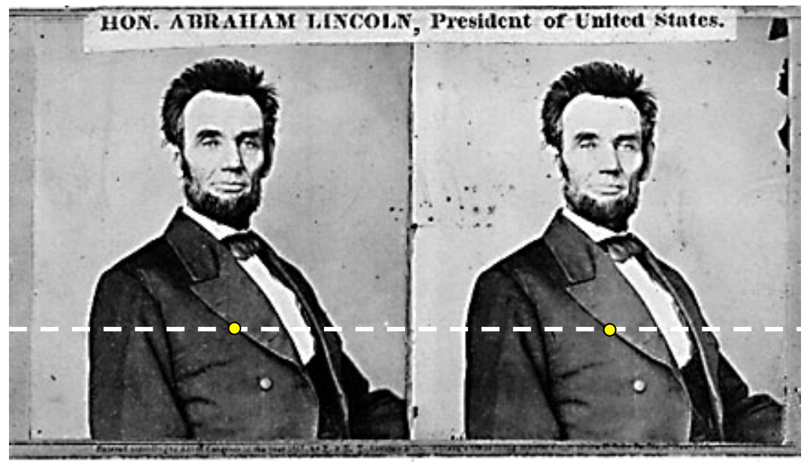
Structure from stereo – Horizantally perfectly aligned cameras - Matching
For each epipolar line For each pixel in the left image compare with every pixel on same epipolar line in right image pick pixel with minimum match cost

Slide 5
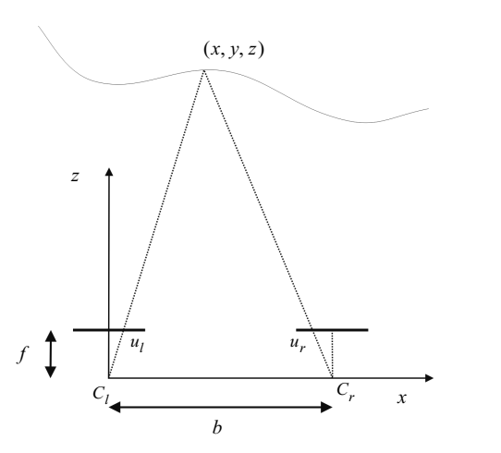
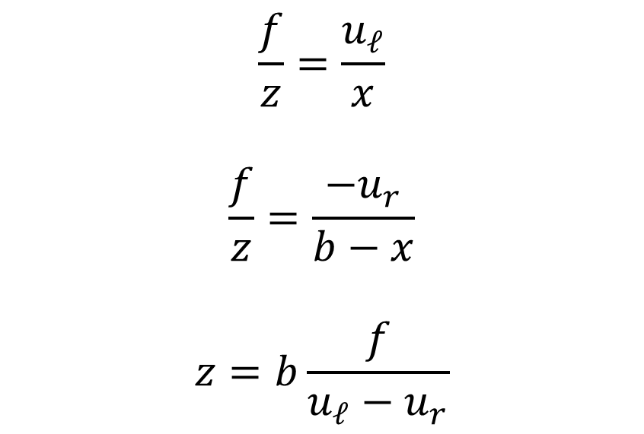
Structure from stereo – Horizantally perfectly aligned cameras – Depth calculation
$$\frac{f}{z}=\frac{u_{ℓ}}{x}$$
$$\frac{f}{z}=\frac{−u_{r}}{b−x}$$
$$z=b\frac{f}{u_{ℓ}−u_{r}}$$

Slide 6
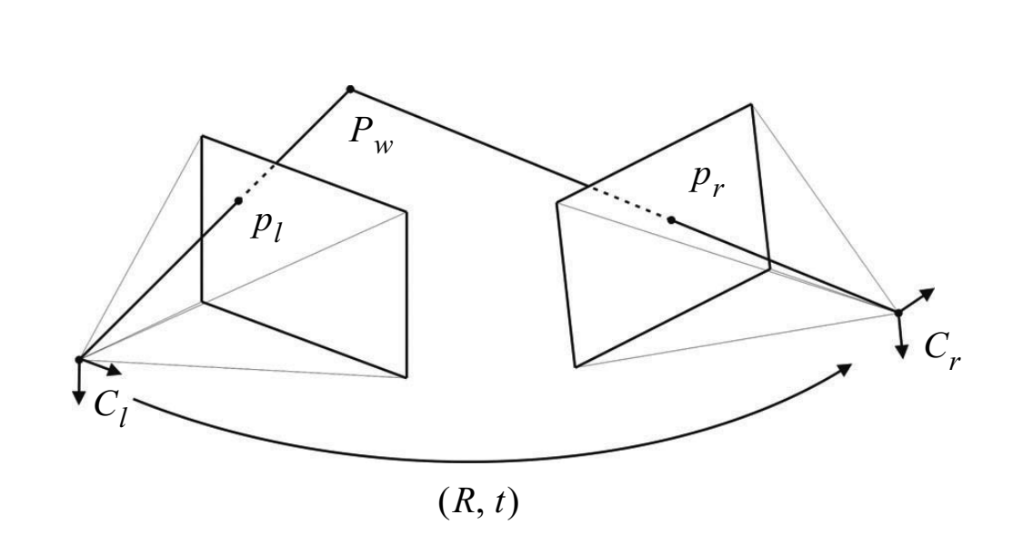
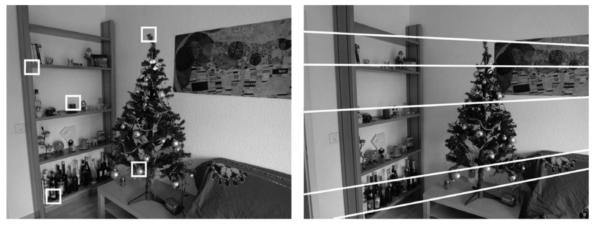
Structure from stereo – General case - Epipolar geometry

Slide 7
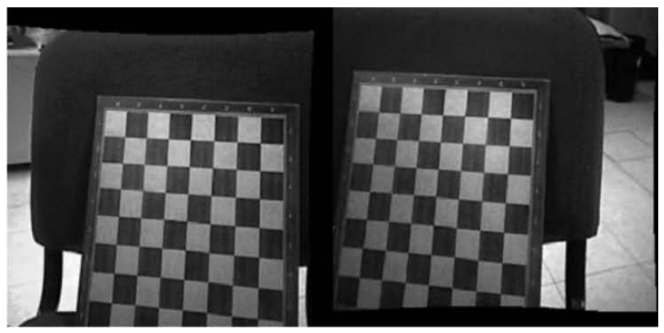
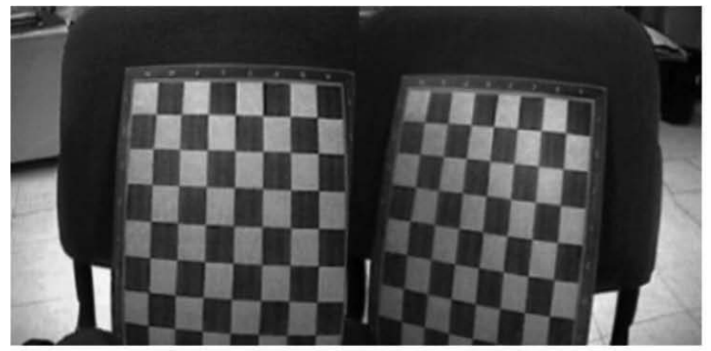
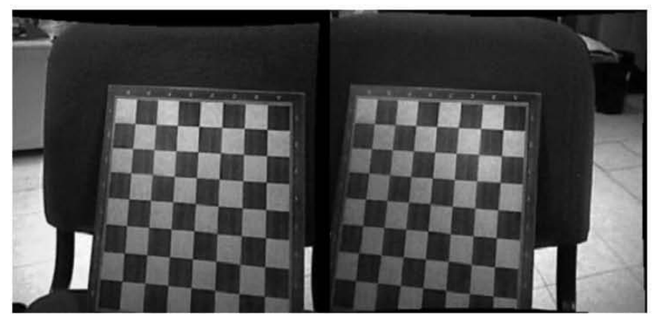
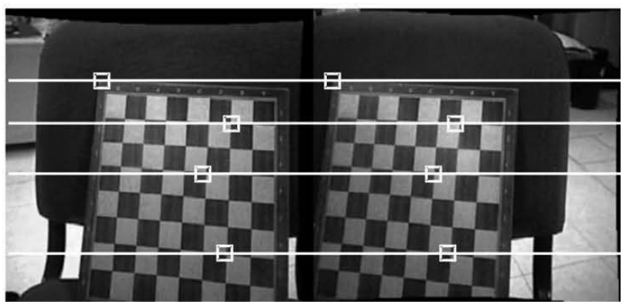
Structure from stereo – General case - Epipolar rectification
Original
Lens distortion
T&R
Horizantal match

Slide 8
Structure from motion
Process two images taken with the same camera at different times and from different unknown positions
Both motion and the structure should be estimated

Slide 9
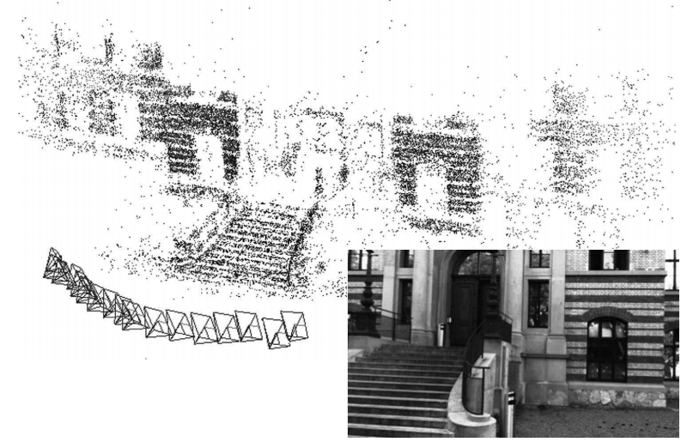
Structure from motion

Slide 10
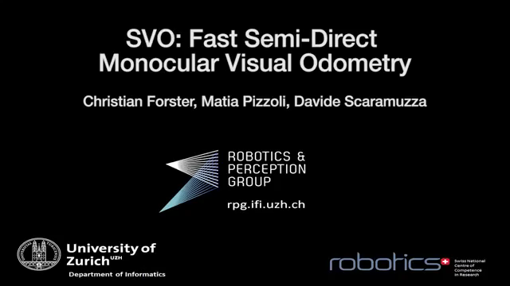
Structure from motion - Visual odometry
https://www.youtube.com/watch?v=2YnIMfw6bJY

Slide 11
Motion field and Optical flow
Motion field : If a point in the environment moves with velocity vo, this correspondes to a motion with velocity vi in image plane
Optical flow : If light source moves the brightness pattern in image moves too
Motion field : real World 3d motion
Optical flow : Projection of the motion field onto the 2D image
Estimate motion by optical flow

Slide 12
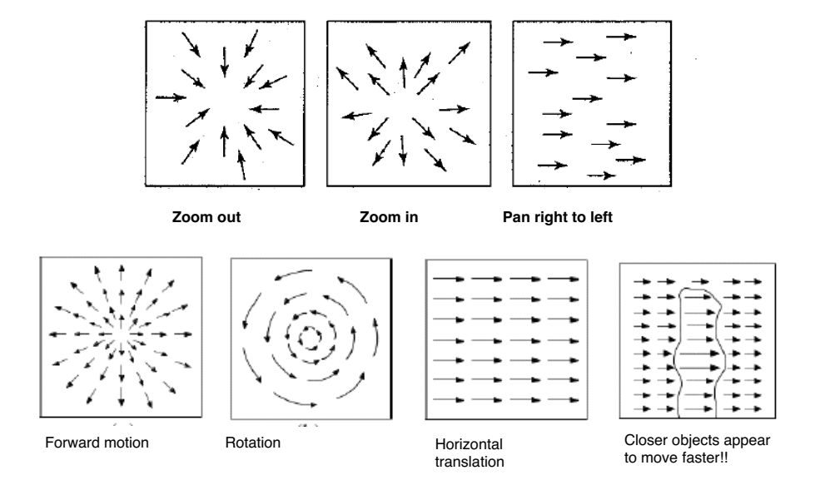
Motion Field

Slide 13
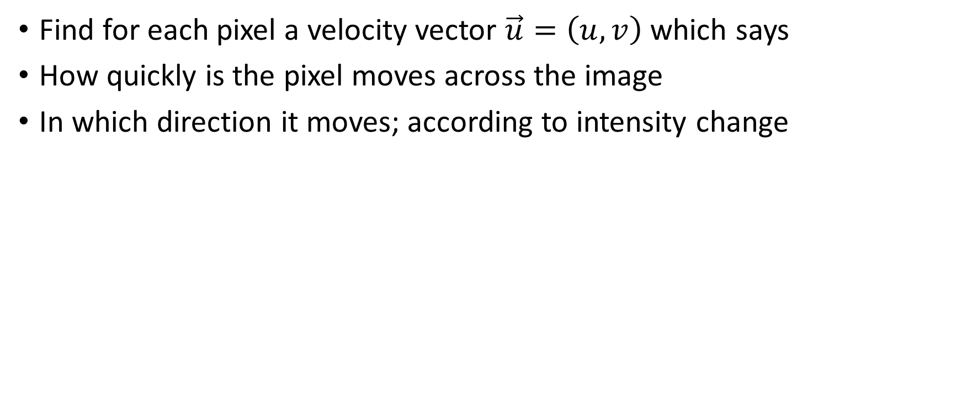
Optical Flow
Find for each pixel a velocity vector $\vec{u}=\left(u,v\right)$ which says
How quickly is the pixel moves across the image
In which direction it moves; according to intensity change

Slide 14
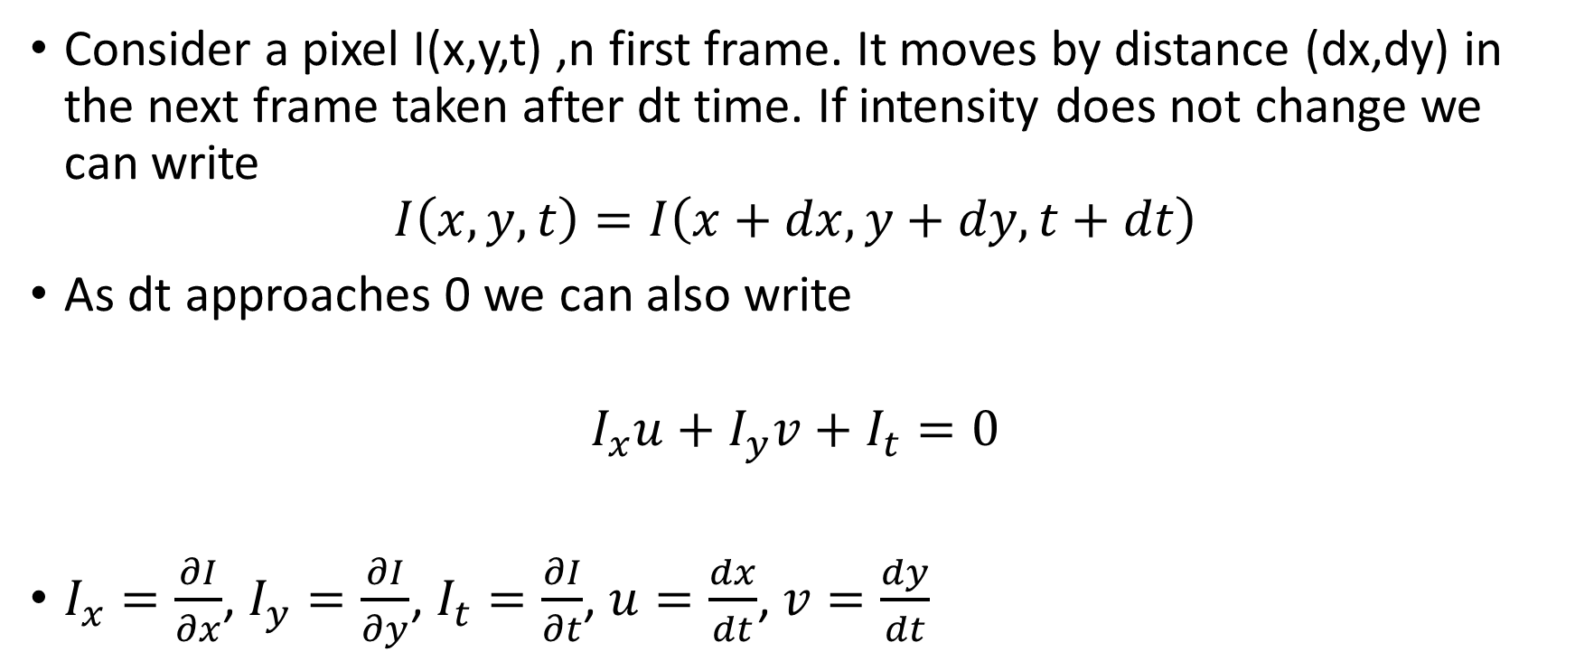
Optical Flow
Consider a pixel I(x,y,t) ,n first frame. It moves by distance (dx,dy) in the next frame taken after dt time. If intensity does not change we can write
$$I\left(x,y,t\right)=I\left(x+dx,y+dy,t+dt\right)$$
As dt approaches 0 we can also write
$$I_{x}u+I_{y}v+I_{t}=0$$
$I_{x}=\frac{∂I}{∂x}$, $I_{y}=\frac{∂I}{∂y}$, $I_{t}=\frac{∂I}{∂t}$, $u=\frac{dx}{dt}$, $v=\frac{dy}{dt}$

Slide 15
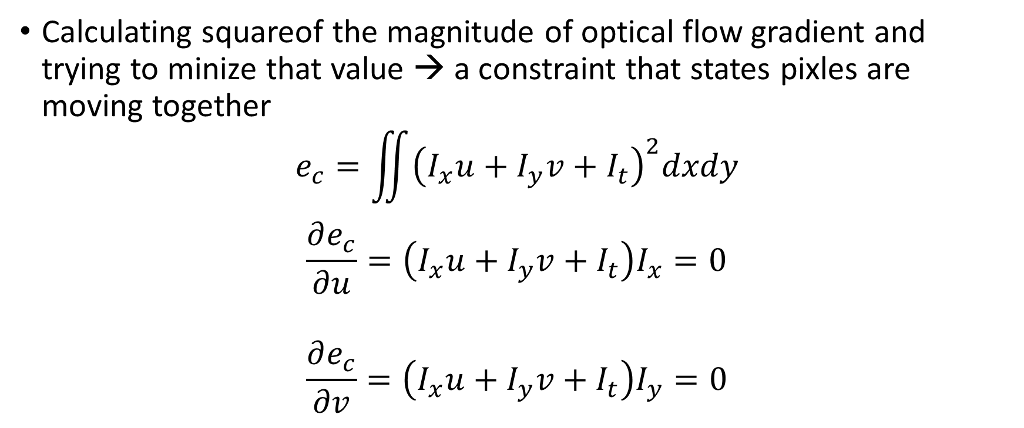
Optical Flow
Calculating squareof the magnitude of optical flow gradient and trying to minize that value → a constraint that states pixles are moving together
$$e_{c}=\iint{{\left(I_{x}u+I_{y}v+I_{t}\right)}^{2}dxdy}$$
$$\frac{∂e_{c}}{∂u}=\left(I_{x}u+I_{y}v+I_{t}\right)I_{x}=0$$
$$\frac{∂e_{c}}{∂v}=\left(I_{x}u+I_{y}v+I_{t}\right)I_{y}=0$$

Slide 16
Color Tracking
Color thresholding
Color Segmentation
Adaptive thresholding
K-means clustering
→ Floor plane extraction

Slide 17
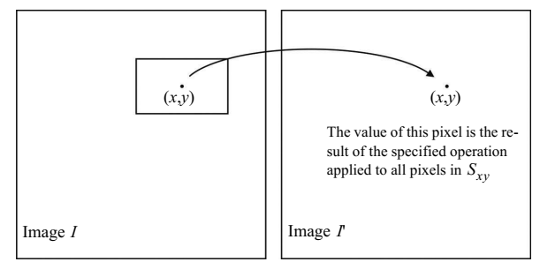
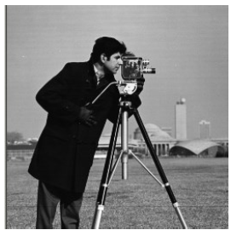
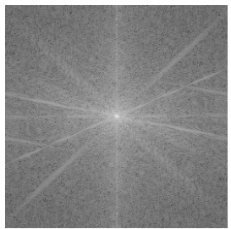

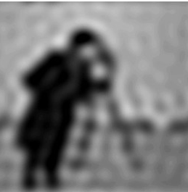
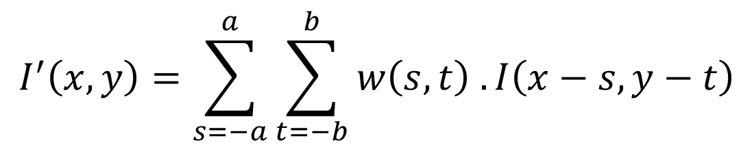
Image Filtering
Frequency domain filtering
Spatial Filtering
$$I^{′}\left(x,y\right)=\sum_{s=−a}^{a}{\sum_{t=−b}^{b}{w\left(s,t\right) .I\left(x−s,y−t\right)}}$$

Slide 18
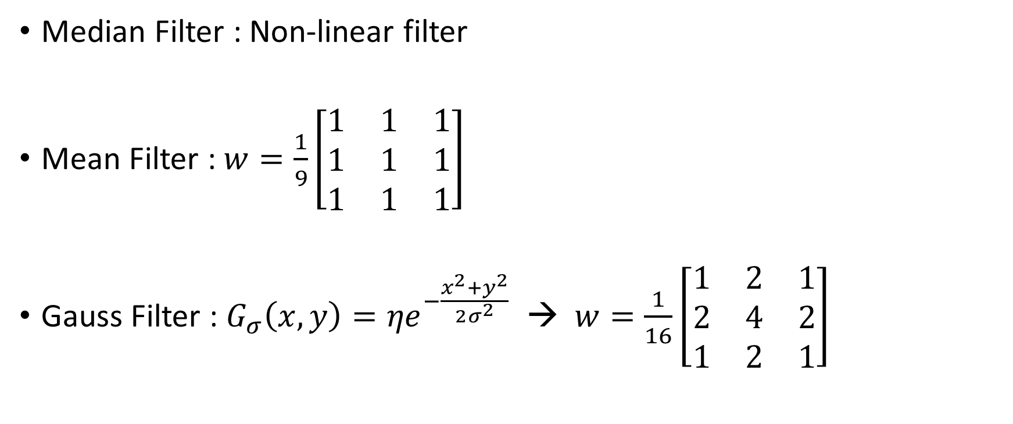
Image Filtering – Spatial Filtering - Smoothing Filters
Median Filter : Non-linear filter
Mean Filter : $w=\frac{1}{9}\left[\begin{matrix}1 & 1 & 1 \\ 1 & 1 & 1 \\ 1 & 1 & 1\end{matrix}\right]$
Gauss Filter : $G_{σ}\left(x,y\right)={ηe}^{−\frac{x^{2}+y^{2}}{2σ^{2}}}$ → $w=\frac{1}{16}\left[\begin{matrix}1 & 2 & 1 \\ 2 & 4 & 2 \\ 1 & 2 & 1\end{matrix}\right]$

Slide 19
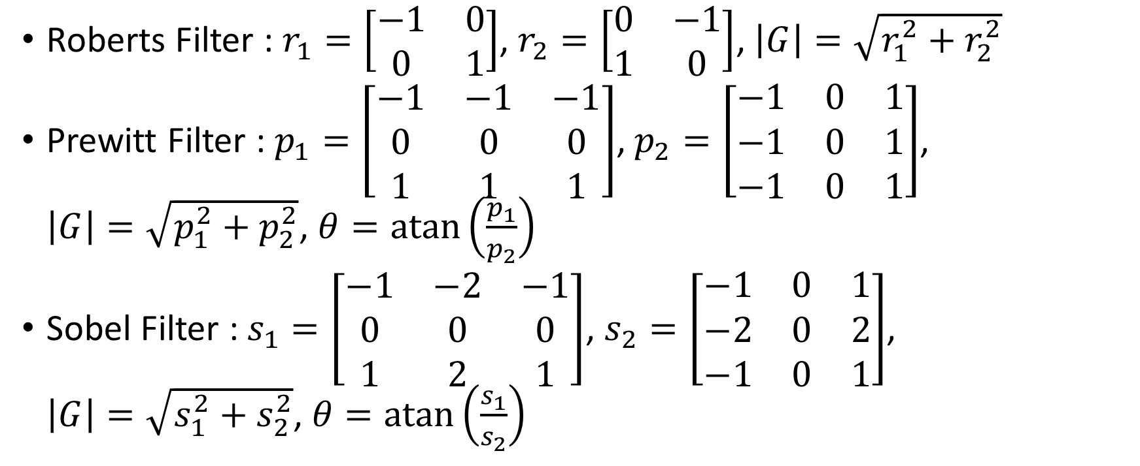
Image Filtering – Spatial Filtering – Edge Detection
Roberts Filter : $r_{1}=\left[\begin{matrix}−1 & 0 \\ 0 & 1\end{matrix}\right]$, $r_{2}=\left[\begin{matrix}0 & −1 \\ 1 & 0\end{matrix}\right]$, $\left|G\right|=\sqrt{r_{1}^{2}+r_{2}^{2}}$
Prewitt Filter : $p_{1}=\left[\begin{matrix}−1 & −1 & −1 \\ 0 & 0 & 0 \\ 1 & 1 & 1\end{matrix}\right]$, $p_{2}=\left[\begin{matrix}−1 & 0 & 1 \\ −1 & 0 & 1 \\ −1 & 0 & 1\end{matrix}\right]$, $\left|G\right|=\sqrt{p_{1}^{2}+p_{2}^{2}}$, $θ=\operatorname{atan}\left(\frac{p_{1}}{p_{2}}\right)$
Sobel Filter : $s_{1}=\left[\begin{matrix}−1 & −2 & −1 \\ 0 & 0 & 0 \\ 1 & 2 & 1\end{matrix}\right]$, $s_{2}=\left[\begin{matrix}−1 & 0 & 1 \\ −2 & 0 & 2 \\ −1 & 0 & 1\end{matrix}\right]$, $\left|G\right|=\sqrt{s_{1}^{2}+s_{2}^{2}}$, $θ=\operatorname{atan}\left(\frac{s_{1}}{s_{2}}\right)$

Slide 20
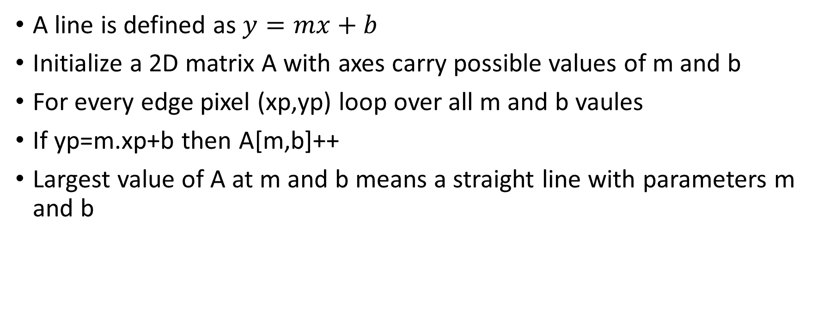
Straight Edge Extraction – Hough Transform
A line is defined as $y=mx+b$
Initialize a 2D matrix A with axes carry possible values of m and b
For every edge pixel (xp,yp) loop over all m and b vaules
If yp=m.xp+b then A[m,b]++
Largest value of A at m and b means a straight line with parameters m and b

Slide 21
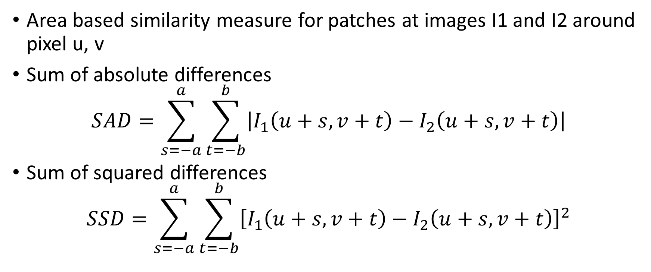
Image Similarity
Area based similarity measure for patches at images I1 and I2 around pixel u, v
Sum of absolute differences
$$SAD=\sum_{s=−a}^{a}{\sum_{t=−b}^{b}{\left|I_{1}\left(u+s,v+t\right)−I_{2}\left(u+s,v+t\right)\right|}}$$
Sum of squared differences
$$SSD=\sum_{s=−a}^{a}{\sum_{t=−b}^{b}{{\left[I_{1}\left(u+s,v+t\right)−I_{2}\left(u+s,v+t\right)\right]}^{2}}}$$

Slide 22
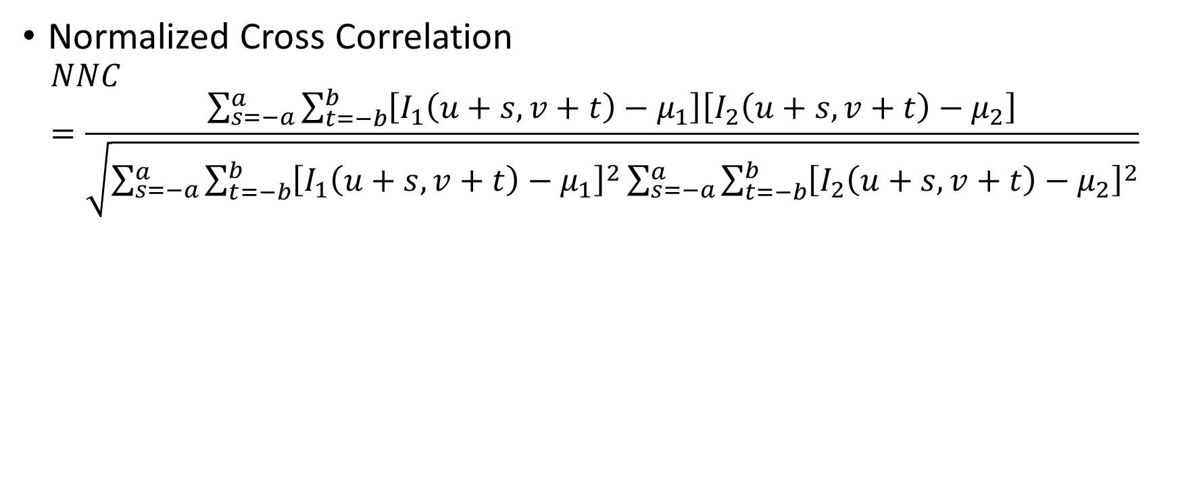
Image Similarity
Normalized Cross Correlation
$$NNC=\frac{\sum_{s=−a}^{a}{\sum_{t=−b}^{b}{\left[I_{1}\left(u+s,v+t\right)−μ_{1}\right]\left[I_{2}\left(u+s,v+t\right)−μ_{2}\right]}}}{\sqrt{\sum_{s=−a}^{a}{\sum_{t=−b}^{b}{{\left[I_{1}\left(u+s,v+t\right)−μ_{1}\right]}^{2}}}\sum_{s=−a}^{a}{\sum_{t=−b}^{b}{{\left[I_{2}\left(u+s,v+t\right)−μ_{2}\right]}^{2}}}}}$$

Slide 23
Feature Extraction
Two strategies for sersor input evaluation
Raw, individual sensor data → low level features
Extract information from one or more sensor readings → high level features

Slide 24
Feature Extraction
Decision on appropriate features
Target environment : Office environment→line features, Mars Rover→ visual odometry
Available sensors : laser range finder→ line features, sonar sensor → single point ranging
Computational power : visual features → costly
Environment representation : continuous rep. → line features, occupancy grid rep. → ranging

Slide 25
Properties of ideal feature detectors
Repeatability
Distinctiveness
Localization accuracy
Quantity of features
Invariance
Computational efficiency
Robustness

Slide 26
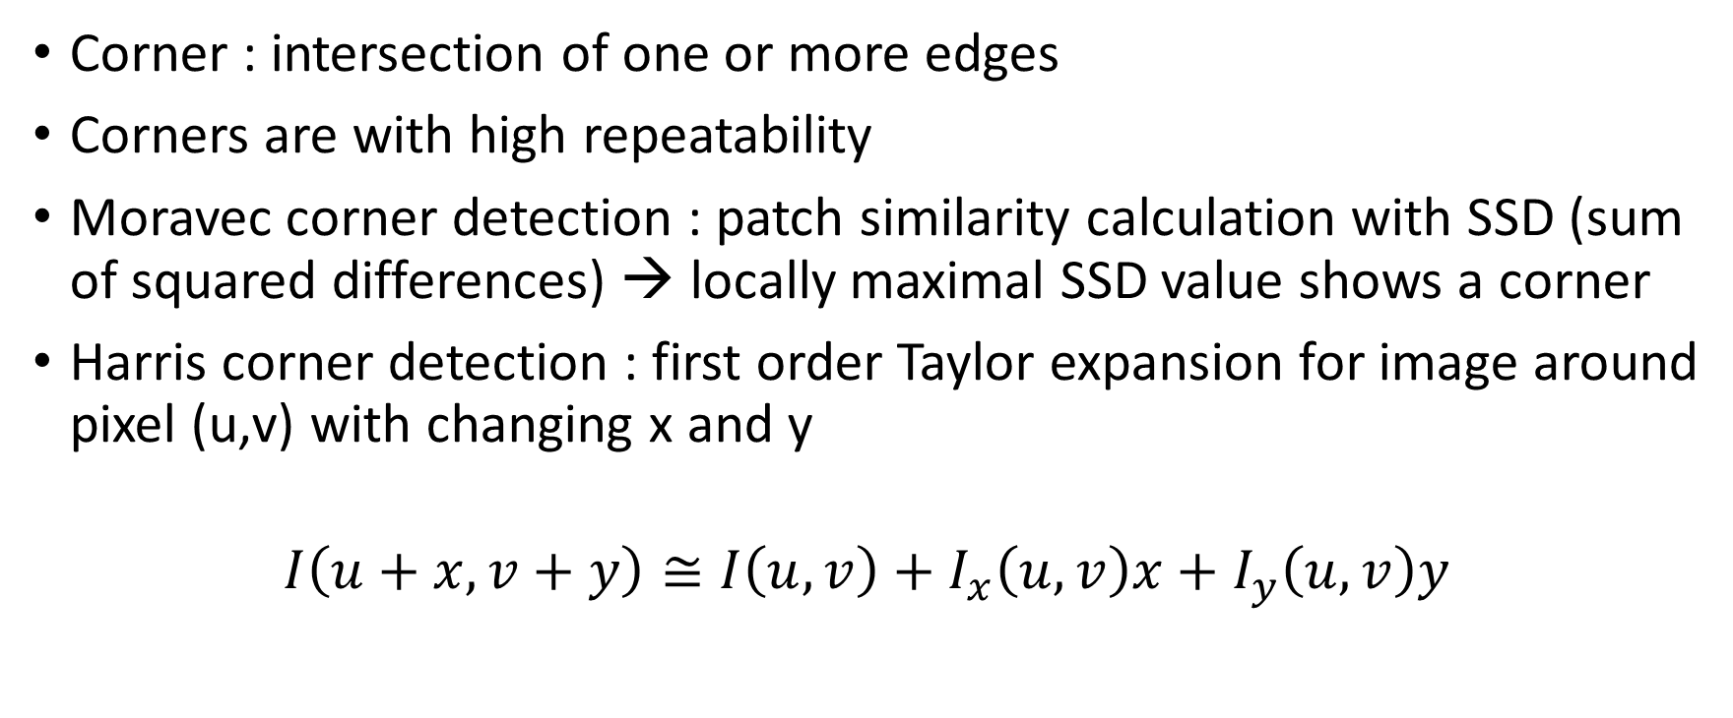
Corner Detectors
Corner : intersection of one or more edges
Corners are with high repeatability
Moravec corner detection : patch similarity calculation with SSD (sum of squared differences) → locally maximal SSD value shows a corner
Harris corner detection : first order Taylor expansion for image around pixel (u,v) with changing x and y
$$I\left(u+x,v+y\right)≅I\left(u,v\right)+I_{x}\left(u,v\right)x+I_{y}\left(u,v\right)y$$

Slide 27
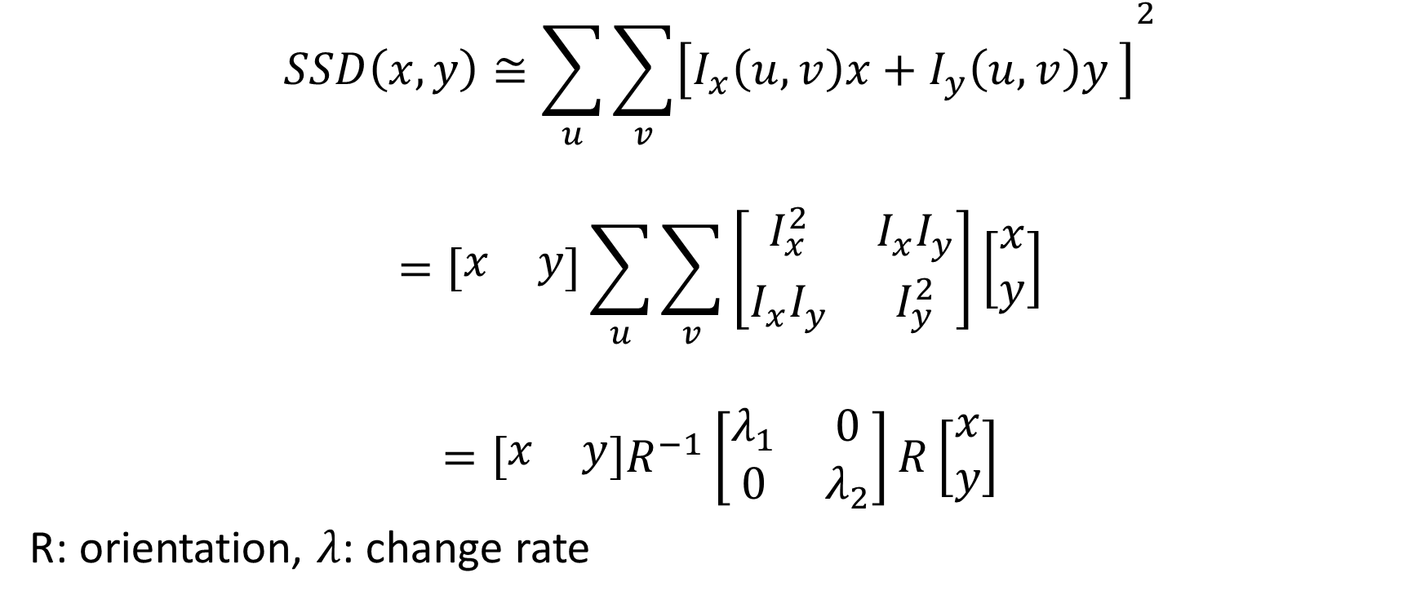
Harris Corner Detector
$$SSD\left(x,y\right)≅\sum_{u}{{\sum_{v}{\left[I_{x}\left(u,v\right)x+I_{y}\left(u,v\right)y \right]}}^{2}}$$
$$=\left[\begin{matrix}x & y\end{matrix}\right]\sum_{u}{\sum_{v}{\left[\begin{matrix}I_{x}^{2} & I_{x}I_{y} \\ I_{x}I_{y} & I_{y}^{2}\end{matrix}\right]}}\left[\begin{matrix}x \\ y\end{matrix}\right]$$
$$=\left[\begin{matrix}x & y\end{matrix}\right]R^{−1}\left[\begin{matrix}λ_{1} & 0 \\ 0 & λ_{2}\end{matrix}\right]R\left[\begin{matrix}x \\ y\end{matrix}\right]$$
R: orientation, $λ$: change rate

Slide 28
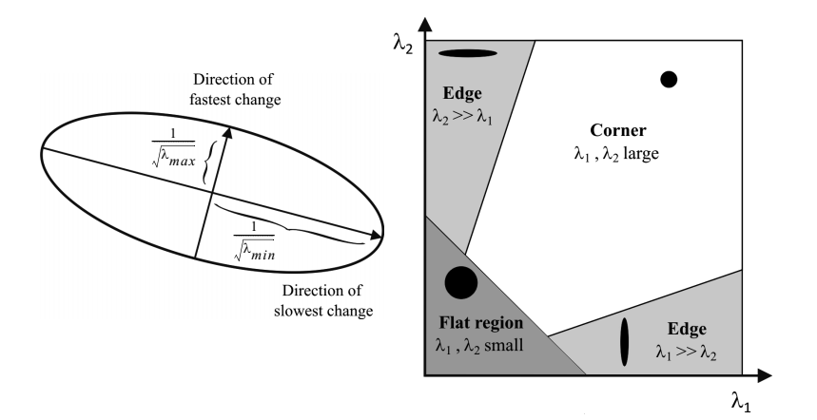
Harris Corner Detector

Slide 29
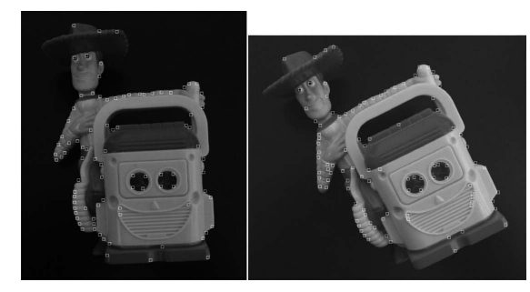
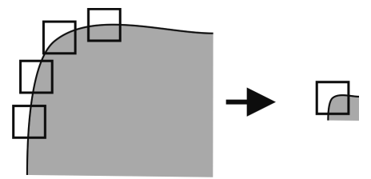
Harris Corner Detector
Harris corner features are repeatable unders rotation and illumination change
Not invariant to scale

Slide 30
Blob Detectors
Blob: an image pattern that differs from its immediate neighborhood in terms of intensty, color and texture
Location accuracy is smaller than a corner
Scale and shape accuracy is better defined compared to a corner

Slide 31
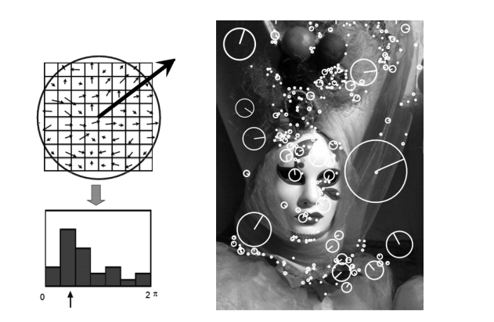
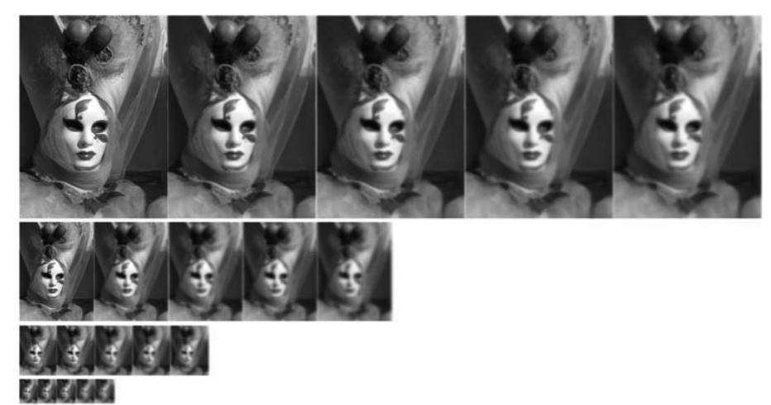
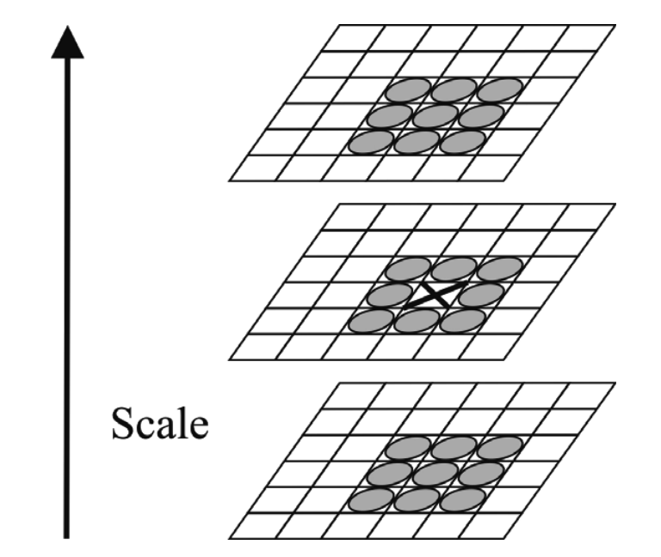
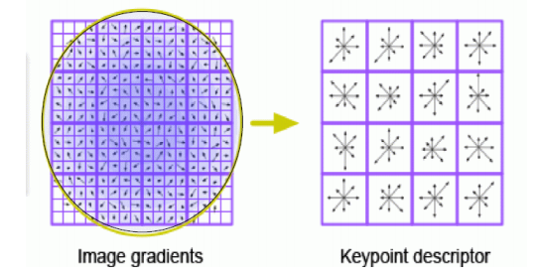
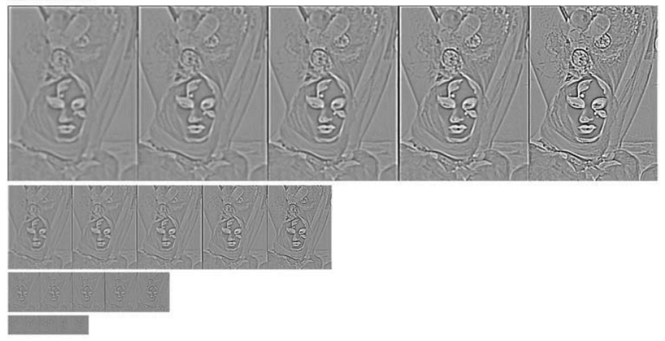
SIFT Features
Gaussian blurred images at different scales.
Difference of Gaussian images. Keypoint selection as local maxima or minima of the DoG images
Orientation assignment
Keypoint descriptor

Slide 32
Feature Extraction Based on Range
How many lines are there?
Which points belong to which line?
Given the point that belong to line, how to estimate line model parameters?

Slide 33
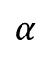
Line Fitting (Answer to 3rd question)
Minimize the discrepancy with all sensor measurements used → least squares estimation
A line can be described by lines perpendicular distance to origin and this perpendicular lines angle to x-axis
r
$$α$$

Slide 34
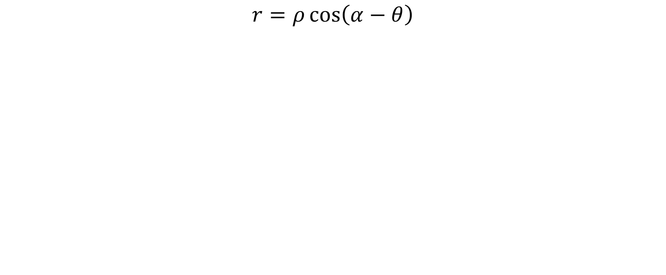


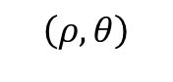
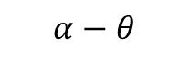
Line Fitting
$$r=ρ\cos\left(α−θ\right)$$
$$\left(ρ,θ\right)$$
r
$$ρ$$
$$α−θ$$
$$θ$$

Slide 35
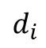
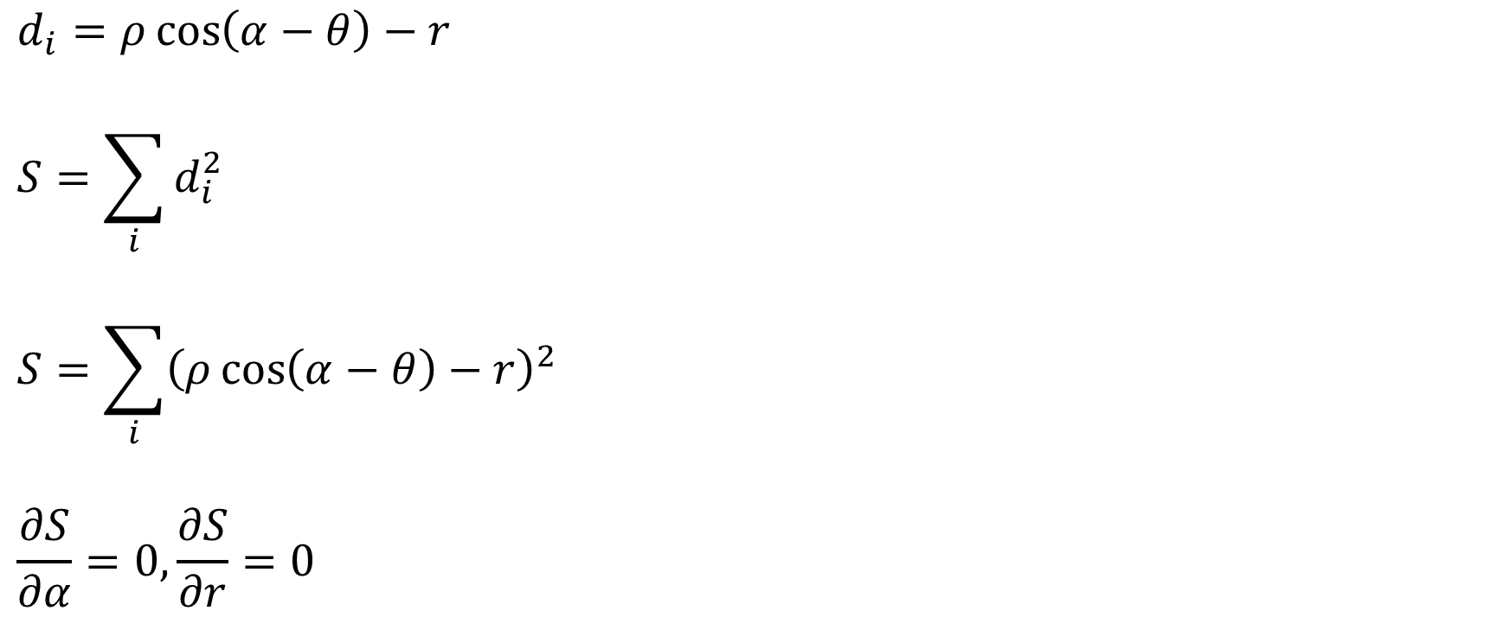


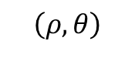
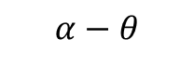
Line Fitting – Unweighted Least Squares
$$d_{i}=ρ\cos\left(α−θ\right)−r$$
$$S=\sum_{i}{d_{i}^{2}}$$
$$S=\sum_{i}{{\left(ρ\cos\left(α−θ\right)−r\right)}^{2}}$$
$$\frac{∂S}{∂α}=0,\frac{∂S}{∂r}=0$$
$$\left(ρ,θ\right)$$
r
$$d_{i}$$
$$ρ$$
$$α−θ$$
$$θ$$

Slide 36
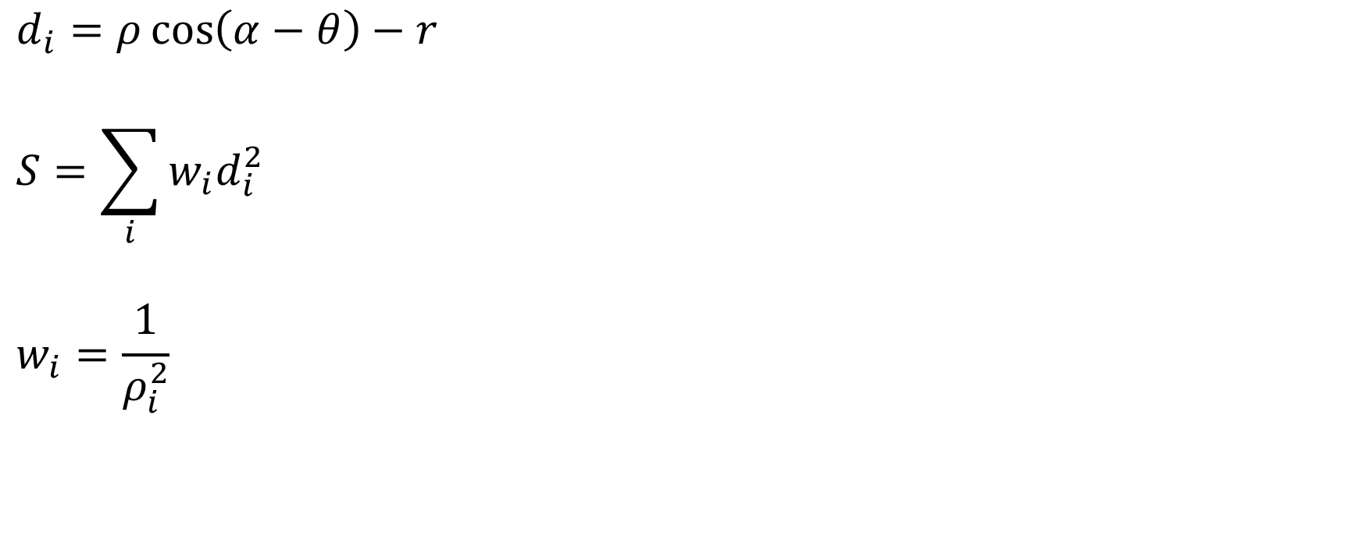
Line Fitting – Unweighted Least Squares
$$d_{i}=ρ\cos\left(α−θ\right)−r$$
$$S=\sum_{i}{w_{i}d_{i}^{2}}$$
$$w_{i}=\frac{1}{ρ_{i}^{2}}$$
$$\left(ρ,θ\right)$$
r
$$d_{i}$$
$$ρ$$
$$α−θ$$
$$θ$$

Slide 37
Line Extraction
Line fitting is easy
Line extraction is hard due to a range measurement may not belong to a single line
Line Extraction methods:
Split and Merge
Line Regression
Incremental
RANSAC
Hough Transform
Expectation Maximization

Slide 38
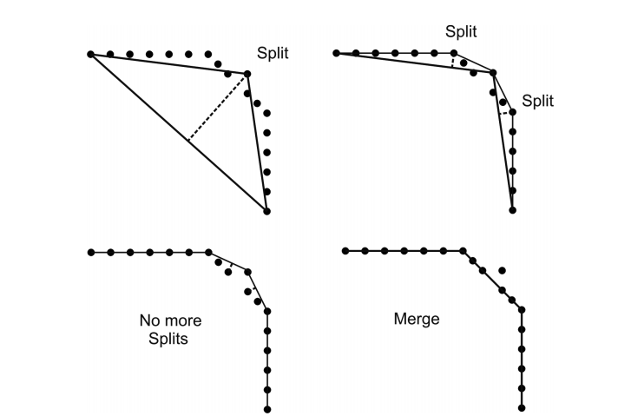
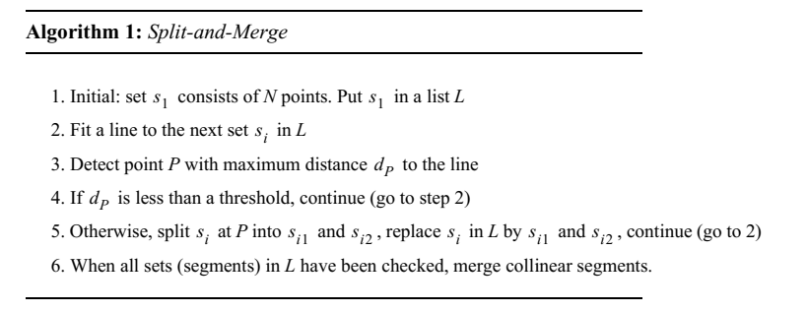
Split and Merge Line Extraction

Slide 39
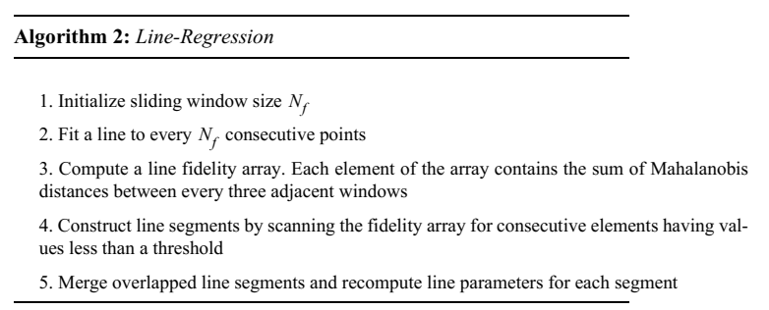
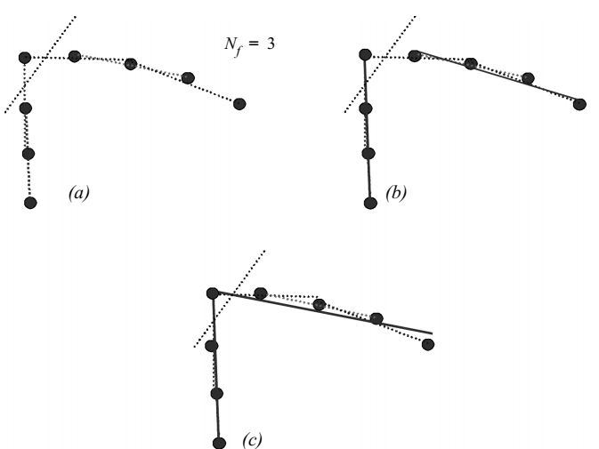
Line Regression – Line Extraction

Slide 40
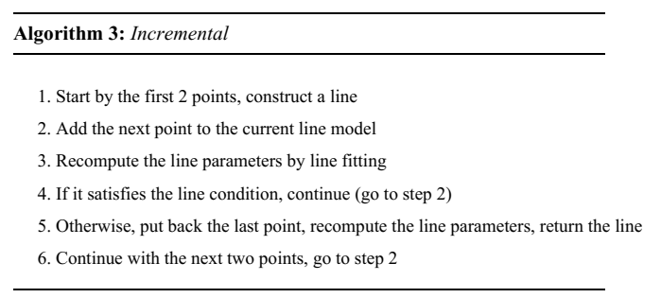
Incremental

Slide 41
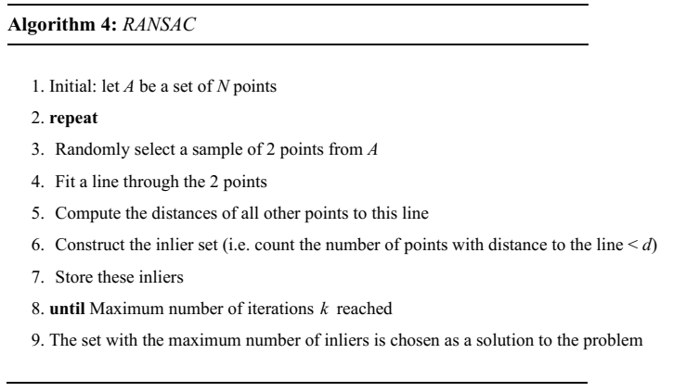

RANSAC (Random Sample Consensus)

Slide 42

Hough Transform

Slide 43

Expectation Maximization

Slide 44

Range Histogram Features

Slide 45

Other Geometric Features

Slide 46
sensor_msgs/LaserScan
# Single scan from a planar laser range-finder # # If you have another ranging device with different behavior (e.g. a sonar # array), please find or create a different message, since applications # will make fairly laser-specific assumptions about this data Header header # timestamp in the header is the acquisition time of # the first ray in the scan. # # in frame frame_id, angles are measured around # the positive Z axis (counterclockwise, if Z is up) # with zero angle being forward along the x axis float32 angle_min # start angle of the scan [rad] float32 angle_max # end angle of the scan [rad] float32 angle_increment # angular distance between measurements [rad] float32 time_increment # time between measurements [seconds] - if your scanner # is moving, this will be used in interpolating position # of 3d points float32 scan_time # time between scans [seconds] float32 range_min # minimum range value [m] float32 range_max # maximum range value [m] float32[] ranges # range data [m] (Note: values < range_min or > range_max should be discarded) float32[] intensities # intensity data [device-specific units]. If your # device does not provide intensities, please leave # the array empty.

Slide 47
sensor_msgs/Image RGB or Depth
# This message contains an uncompressed image # (0, 0) is at top-left corner of image # Header header # Header timestamp should be acquisition time of image # Header frame_id should be optical frame of camera # origin of frame should be optical center of cameara # +x should point to the right in the image # +y should point down in the image # +z should point into to plane of the image # If the frame_id here and the frame_id of the CameraInfo # message associated with the image conflict # the behavior is undefined uint32 height # image height, that is, number of rows uint32 width # image width, that is, number of columns # The legal values for encoding are in file src/image_encodings.cpp # If you want to standardize a new string format, join # ros-users@lists.sourceforge.net and send an email proposing a new encoding. string encoding # Encoding of pixels -- channel meaning, ordering, size # taken from the list of strings in include/sensor_msgs/image_encodings.h uint8 is_bigendian # is this data bigendian? uint32 step # Full row length in bytes uint8[] data # actual matrix data, size is (step * rows)

Slide 48
sensor_msgs/PointCloud
# This message holds a collection of 3d points, plus optional additional # information about each point. # Time of sensor data acquisition, coordinate frame ID. Header header # Array of 3d points. Each Point32 should be interpreted as a 3d point # in the frame given in the header. geometry_msgs/Point32[] points # Each channel should have the same number of elements as points array, # and the data in each channel should correspond 1:1 with each point. # Channel names in common practice are listed in ChannelFloat32.msg. ChannelFloat32[] channels

Slide 49

cv_bridge

Slide 50
Cv_brigde example
Example

